Slide 1
Lecture 6 Brute Force

Slide 2

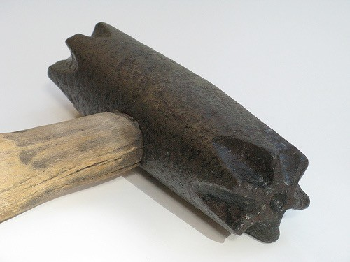
Brute Force
(just do it)
Come up with all possible solutions or states...

Slide 3
Brute force algorithm
A brute force algorithm simply tries all possibilities until a satisfactory solution is found
Such an algorithm can be:
Optimizing: Find the best solution. This may require finding all solutions, or if a value for the best solution is known, it may stop when any best solution is found
Example: Finding the best path for a traveling salesman
Satisficing: Stop as soon as a solution is found that is good enough
Example: Finding a traveling salesman path that is within 10% of optimal

Slide 4
Brute Force is Good...
Can be applied to most
problems ...resulting in reasonable algorithms.
Generally cheap to design and implement.
Useful for small size instances of the problems.
Generating and checking solutions can occur in parallel.

Slide 5

Finding a phone number
Consider the problem of trying to find a telephone number in a phone book.
Aabataglilia A. ........9317 4532
Aabhas A. ...........0433 26 1471
Aabid Y & H. ............9729 8181
Aabryn B & K. ........ 9561 8162

Slide 6






Approach
Prints the name associated to a phone number
(if the number exists in the telephone book)
Input: phoneNum, a phone number
Output: Name corresponding to the phoneNum
Look at the first record
Does the record have the phone number?
yes
print name
no
Is there another record?
stop
yes
Look at the next record

Slide 7
Sequential Search
Given a value: target, and a list L.
Find the first item in L, which has the value target.
Return:
If target is found then return the index of the item.
If target not found then return -1.

Slide 8





Algorithm: Sequential Search
Search for target in L
Input: target, and a list L[0..n-1]
Output: If target is in L, returns the index of the first item with that value. Otherwise returns -1.
k ← 0
yes
k = length(L)
return -1
no
yes
L[k] = target?
return k
no
k ← k +1

Slide 9

Algorithm: Sequential Search
Search for target in L
Input: target, and a list L[0, n-1]
Output: If target is in L, returns the index of the first item with that value. Otherwise returns -1.
k ← 0
SequentialSearch(target, L) k ← 0
while (k ≠ length(L)) do
{
if (L[k] = target )
{
return k
}
k ← k+1
}
return -1
yes
k = length(L)
return -1
no
yes
L[k] = target?
return k
no
k ← k +1

Slide 10
Algorithm: Sequential Search
Input: target, and a list L[0.. n-1]
Output: If target is in L, returns the index of the first item with that value. Otherwise returns -1.
input: L = [3,1,4,5,9,2,6]; target =2
output: 5
SequentialSearch(target, L) k ← 0
while (k ≠ length(L)) do
{
if (L[k] = target )
{
return k
}
k ← k+1
}
return -1
input: L = [ ]; target =2
output: -1
input: L = [2,2,3,5,9,2]; target =2
output: 0
input: L = [3,1,4,9,5,6,1]; target =5
output: 4
input: L = [3,1,4,9,5,6,1]; target =8
output: -1

Slide 11
Is the substring cagcag in this string?
atggctaagtctatgctttctggaattgtttttgctggtcttgttgct gctgcagcggccagttcggccaacaacagcgccgccaa cgtctccgttttggagagtgggcccgctgtgcaggaagtgc cagcgcgcacggtcacagctcgcctggcgaagcctttgct gcttcttttctgctcttgctgcgactttggcagcagct
Yes
No

Slide 12
String Matching
is T a substring of S?
A substring of a string S is another string T "that occurs in" S.

Slide 13
Brute Force String Matching
cagcag
atggctaagtctatgctttctggaattgtttttgctggtcttgttg ctgctgcagcggccagttcggccaacaacagcgccgc caacgtctccgttttggagagtgggcccgctgtgcaggaa gtgccagcgcgcacggtcacagctcgcctggcgaagc ctttgctgcttcttttctgctcttgctgcgactttggcagcagct

Slide 14
Brute Force String Matching
cagcag
atggctaagtctatgctttctggaattgtttttgctggtcttgttg ctgctgcagcggccagttcggccaacaacagcgccgc caacgtctccgttttggagagtgggcccgctgtgcaggaa gtgccagcgcgcacggtcacagctcgcctggcgaagc ctttgctgcttcttttctgctcttgctgcgactttggcagcagct

Slide 15
Brute Force String Matching
cagcag
atggctaagtctatgctttctggaattgtttttgctggtcttgttg ctgctgcagcggccagttcggccaacaacagcgccgc caacgtctccgttttggagagtgggcccgctgtgcaggaa gtgccagcgcgcacggtcacagctcgcctggcgaagc ctttgctgcttcttttctgctcttgctgcgactttggcagcagct

Slide 16
Brute Force String Matching
cagcag
atggctaagtctatgctttctggaattgtttttgctggtcttgttg ctgctgcagcggccagttcggccaacaacagcgccgc caacgtctccgttttggagagtgggcccgctgtgcaggaa gtgccagcgcgcacggtcacagctcgcctggcgaagc ctttgctgcttcttttctgctcttgctgcgactttggcagcagct

Slide 17
Brute Force String Matching
cagcag
atggctaagtctatgctttctggaattgtttttgctggtcttgttg ctgctgcagcggccagttcggccaacaacagcgccgc caacgtctccgttttggagagtgggcccgctgtgcaggaa gtgccagcgcgcacggtcacagctcgcctggcgaagc ctttgctgcttcttttctgctcttgctgcgactttggcagcagct

Slide 18



Algorithm: StringMatch
Checks if a string T is a substring of S Input: string S, potential substring T Output: true if T is in S, false if T is not in S.
Look athe the first length(T) carachters of S
Does the substring match T?
yes
return
true
no
Are we at the end of S?
yes
return
false
no
Move one character along S

Slide 19
Strings as Lists
Str
a
t
g
Str = [a, t, g] or Str = “atg” Str[1] = “t”
Str[1..2] = [t, g] = “tg”
Str[0..1] = [a, t] = “at”
Substrings

Slide 20
Str = [a, g, t, t, a, c, g, a, t, t, a]
0 1 2 3 4 5 6 7 8 9 10
Str[2..4] = [t, t, a]
Str[3..5] = [t, a, c]
Str[8 ..10] = [t, t, a]

Slide 21
Algorithm: StringMatch(S, T)
Checks if T is a substring of S
Input: string S, substring T
Output: true if T is in S, false if T is not in S.
k ← 0
while (k + length(T) ≤ length(S)) do
{
If (S[k .. k+length(T)-1] = T)
{
return true
}
k ← k + 1
}
return false

Slide 22

T = cagcag
lenght(T) = 6
atggctaagtctatgctttctggaattgtttttgctggtcttgttg ctgctgcagcggccagttcggccaacaacagcgccgc caacgtctccgttttggagagtgggcccgctgtgcaggaa gtgccagcgcgcacggtcacagctcgcctggcgaagc ctttgctgcttcttttctgctcttgctgcgactttggcagcagct
k=0
k+lenght(T)-1=5

Slide 23
T = cagcag
lenght(T) = 6
atggctaagtctatgctttctggaattgtttttgctggtcttgttg ctgctgcagcggccagttcggccaacaacagcgccgc caacgtctccgttttggagagtgggcccgctgtgcaggaa gtgccagcgcgcacggtcacagctcgcctggcgaagc ctttgctgcttcttttctgctcttgctgcgactttggcagcagct
k=1
k+lenght(T)-1=6

Slide 24
T = cagcag
lenght(T) = 6
atggctaagtctatgctttctggaattgtttttgctggtcttgttg ctgctgcagcggccagttcggccaacaacagcgccgc caacgtctccgttttggagagtgggcccgctgtgcaggaa gtgccagcgcgcacggtcacagctcgcctggcgaagc ctttgctgcttcttttctgctcttgctgcgactttggcagcagct
k=2
k+lenght(T)-1=7

Slide 25

T = cagcag
lenght(T) = 6
atggctaagtctatgctttctggaattgtttttgctggtcttgttg ctgctgcagcggccagttcggccaacaacagcgccgc caacgtctccgttttggagagtgggcccgctgtgcaggaa gtgccagcgcgcacggtcacagctcgcctggcgaagc ctttgctgcttcttttctgctcttgctgcgactttggcagcagct
k=3
k+lenght(T)-1=8

Slide 26




Check substring given by k
Str[k..k+lenght(T)-1] has size length(T)
k
k+ length(T)-1

Slide 27

Start checking at the beginning
Are there enough characters left?
k + length(T) is the
size of we have covered
k ← 0
while (k + length(T) ≤ length(S)) do
{
If (S[k .. k+length(T)-1] = T)
{
return true
}
k ← k + 1
}
return false
Check substring given by k
Str[k..k+lenght(T)-1] has size length(T)
k
k+ length(T)-1
Ready for another substring

Slide 28
while (k + length(T) ≤ length(S)) do
k ← 0
{
If (S[k .. k+length(T)-1] = T)
{
return true
}
k ← k + 1
}
return false

Slide 29
k ← 0
while (k + length(T) ≤ length(S)) do
{
j ← 0
match ← true
while (j < length(T) and match = true) do
{
If (S[j+k] ≠ T[j]) { match ← false
}
j ← j+1
}
If (match == true)
{
return true
}
k ← k + 1
}
return false
k ← 0
while (k + length(T) ≤ length(S)) do
{
If (S[k .. k+length(T)-1] = T)
{
return true
}
k ← k + 1
}
return false

Slide 30






Check substring given by k
j ← 0
match ← true
while (j < length(T) and match = true) do
{
If (S[j+k] ≠ T[j]) { match ← false
}
j ← j+1
}
Str[k..k+lenght(T)-1] has size length(T)
k
k+ length(T)-1
j
T

Slide 31
k ← 0
while (k + length(T) ≤ length(S)) do
{
j ← 0
match ← true
while (j < length(T) and match = true) do
{
If (S[j+k] ≠ T[j]) {
match ← false
}
j ← j+1
}
If (match == true)
{
return true
}
k ← k + 1
}
return false
k ← 0
while (k + length(T) ≤ length(S)) do
{
If (S[k .. k+length(T)-1] == T)
{
return true
}
k ← k + 1
}
return false

Slide 32
Why a,g, t and c?

Slide 33

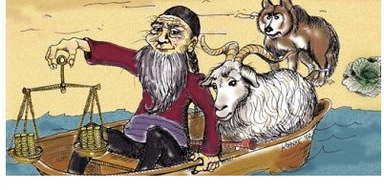
A Boat Problem
A farmer wishes to take a goat, a cabbage and a wolf across a river. However, his boat can only take one of them at a time. Therefore he will need to make several trips. Also, he cannot leave the goat alone with the cabbage, and cannot leave the wolf alone with the goat.
Find a way for the farmer to get everything across the river.
Cover Design of Anany Levitin, Introduction to the Design and Analysis of Algorithms (2nd Edition)

Slide 34
Right of the river
Left of the river
farmer
wolf
cabbage goat

Slide 35
Left of the river
Right of the river
farmer
wolf
cabbage goat

Slide 36
Right of the river
Left of the river
farmer
goat
cabbage
wolf

Slide 37
Right of the river
Left of the river
farmer cabbage
goat wolf

Slide 39
List States
Farmer | Wolf | Goat | Cabbage
R | R | R | R
R | R | R | L
R | R | L | R
R | R | L | L
R | L | R | R
R | L | R | L
R | L | L | R
R | L | L | L
L | R | R | R
L | R | R | L
L | R | L | R
L | R | L | L
L | L | R | R
L | L | R | L
L | L | L | R
L | L | L | L
END
START
R = right side of the river L = left side of the river

Slide 40
List States
Farmer Wolf Goat Cabbage
R R R R
R R R L
R R L R
R R L L
R L R R
R L R L
R L L R
R L L L
L R R R
L R R L
L R L R
L R L L
L L R R
L L R L
L L L R
L L L L
END
START
R = right side of the river L = left side of the river

Slide 41
Representation of States
Farmer | Wolf | Goat | Cabbage
R | R | R | R | FWGC
R | R | R | L | FWGc
R | R | L | R | FWgC
R | L | R | R | fwGC
R | L | R | L | FwGc
L | R | L | R | fWgC
L | R | L | L | fWgc
L | L | R | L | fwGc
L | L | L | R | fwgC
L | L | L | L | fwgc
!
!
R means they are on the right side of the river
L means they are on the left side of the river
!
!
lower case they on the left side
UPPER CASE they on the right side

Slide 42
Representation of States
Farmer |  | Wolf | Goat | Cabbage
 | R | R | R | R | FWGC
 | R | R | R | L | FWGc
 | R | R | L | R | FWgC
 | R | L | R | R | fwGC
 | R | L | R | L | FwGc
 | L | R | L | R | fWgC
 | L | R | L | L | fWgc
 | L | L | R | L | fwGc
 | L | L | L | R | fwgC
 | L | L | L | L | fwgc
!
!
R means they are on the right side of the river
L means they are on the left side of the river
!
!
lower case they on the left side
UPPER CASE they on the right side

Slide 43
Representation of States
Farmer
Wolf
Goat
Cabbage
R
R
R
R
FWGC
R
R
R
L
FWGc
R
R
L
R
FWgC
R
L
R
R
fwGC
R
L
R
L
FwGc
L
R
L
R
fWgC
L
R
L
L
fWgc
L
L
R
L
fwGc
L
L
L
R
fwgC
L
L L L fwgc
R means they are on the right side of the river
L means they are on the left side of the river
!
!
!
!
lower case they on the left side
UPPER CASE they on the right side

Slide 44
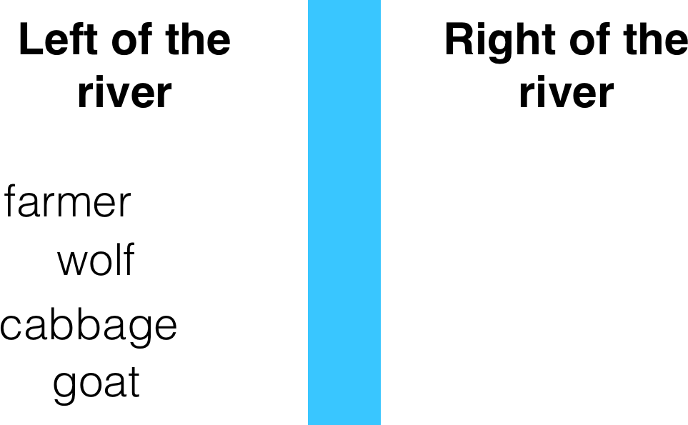
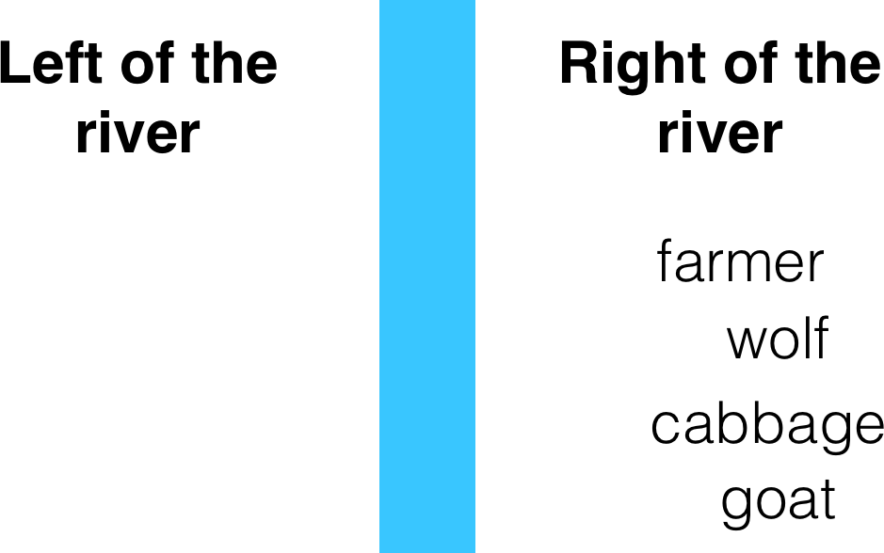
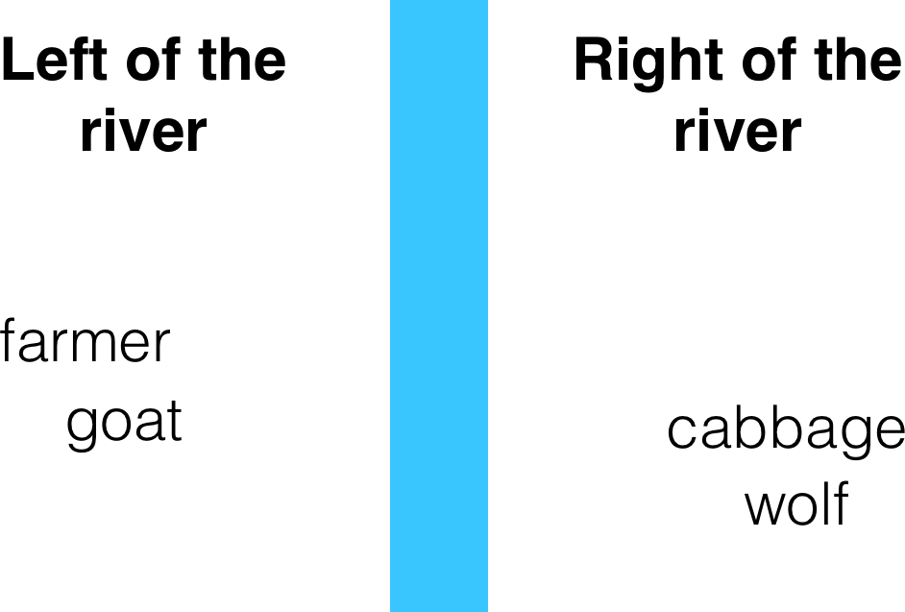
FWGC
fwgc
fWgC

Slide 45
Representation of States
Farmer | Wolf | Goat | Cabbage
R | R | R | R | FWGC
R | R | R | L | FWGc
R | R | L | R | FWgC
R | L | R | R | fwGC
R | L | R | L | FwGc
L | R | L | R | fWgC
L | R | L | L | fWgc
L | L | R | L | fwGc
L | L | L | R | fwgC
L | L | L | L | fwgc
Final State
Start State
!
!
!
!
R means they are on the right side of the river L means they are on the left side of the river lower case they on the left side
UPPER CASE they on the right side

Slide 46
Transitions between states
fwgC
fwGc
fWgc
fwgc
FWGC
fWgC
FWGc
FwGc
FWgC
FwGC

Slide 47
Transitions between states
fwgC
fwGc
fWgc
fwgc
FWGC
fWgC
FWGc
FwGc
FWgC
FwGC

Slide 48
farmer cabbage
goat wolf
fwgC
fwGc
fWgc
fwgc
FWGC
fWgC
FWGc
FwGc
FWgC
FwGC

Slide 49
Boat Solution
FwGC
fwgC
fwgc
FwGc
fwGc
FWgC
fWgC
FWGC
FWGc
fWgc

Slide 50
Brute force approach to the boat problem
List all possible states
Eliminate states that are not valid
Identify transitions between states
Look for a path that starts at the initial state, and ends at the end state

Slide 51
Brute Force Examples
Examples:
Computing a^{n} (a > 0, n a nonnegative integer)
Computing n!
Multiplying two matrices
Searching for a key of a given value in a list

Slide 52
Polynomial Evaluation: Improvement
We can do better by evaluating from right to left:
Better brute-force algorithm
Efficiency:
Horner’s Rule is another linear time method.
Problem: Find the value of polynomial
p(x) = a_{n}x^{n} + a_{n-1}x^{n-1} +… + a₁x¹ + a₀
p ← a[0]
power ← 1
for i ← 1 to n do
power ← power ∗ x
p ← p + a[i] ∗ power
return p
Θ(n) multiplications

Slide 53
Closest-Pair Problem
Find the two closest points in a set of n points (in the two-dimensional Cartesian plane).
Brute-force algorithm
Compute the distance between every pair of distinct points
and return the indexes of the points for which the distance is the smallest.
Notes:
Draw example.

Slide 54
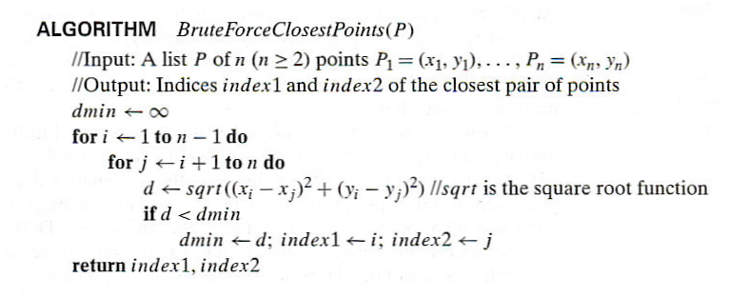
Closest-Pair Brute-Force Algorithm (cont.)
Efficiency:
How to make it faster?
Θ(n^2) multiplications (or sqrt)
Using divide-and-conquer!
Notes:
The basic operation of the algorithm is computing the Euclidean distance between two points.
The square root is a complex operation who’s result is often irrational, therefore the results
can be found only approximately. Computing such operations are not trivial. One can avoid
computing square roots by comparing distance squares instead.

Slide 55
Brute-Force Strengths and Weaknesses
Strengths
wide applicability
simplicity
yields reasonable algorithms for some important problems (e.g., matrix multiplication, sorting, searching, string matching)
Weaknesses
rarely yields efficient algorithms
some brute-force algorithms are unacceptably slow
not as constructive as some other design techniques

Slide 56
Exhaustive Search
A brute force solution to a problem involving search for an element with a special property, usually among combinatorial objects such as permutations, combinations, or subsets of a set.
Method:
generate a list of all potential solutions to the problem in a systematic manner (see algorithms in Sec. 5.4)
evaluate potential solutions one by one, disqualifying infeasible ones and, for an optimization problem, keeping track of the best one found so far
when search ends, announce the solution(s) found

Slide 57
Example 1: Traveling Salesman Problem
Given n cities with known distances between each pair, find the shortest tour that passes through all the cities exactly once before returning to the starting city
Alternatively: Find shortest Hamiltonian circuit in a weighted connected graph
Example:
2
a
b
5
3
8
4
c
d
7
How do we represent a solution (Hamiltonian circuit)?

Slide 58
TSP by Exhaustive Search
Tour Cost
a→b→c→d→a 2+3+7+5 = 17
a→b→d→c→a 2+4+7+8 = 21
a→c→b→d→a 8+3+4+5 = 20
a→c→d→b→a 8+7+4+2 = 21
a→d→b→c→a 5+4+3+8 = 20
a→d→c→b→a 5+7+3+2 = 17
Efficiency:
Θ((n-1)!)

Slide 59
Example 2: Knapsack Problem
Given n items:
weights: w₁ w₂ … w_{n}
values: v₁ v₂ … v_{n}
a knapsack of capacity W
Find most valuable subset of the items that fit into the knapsack
Example: Knapsack capacity W=16
item weight value
2 $20
5 $30
10 $50
5 $10

Slide 60
Knapsack Problem by Exhaustive Search
Subset Total weight Total value
{1} 2 $20
{2} 5 $30
{3} 10 $50
{4} 5 $10
{1,2} 7 $50
{1,3} 12 $70
{1,4} 7 $30
{2,3} 15 $80
{2,4} 10 $40
{3,4} 15 $60
{1,2,3} 17 not feasible
{1,2,4} 12 $60
{1,3,4} 17 not feasible
{2,3,4} 20 not feasible
{1,2,3,4} 22 not feasible
Efficiency:
Θ(2^n)
Each subset can be represented by a binary string (bit vector, Ch 5).

Slide 61
Example 3: The Assignment Problem
There are n people who need to be assigned to n jobs, one person per job. The cost of assigning person i to job j is C[i,j]. Find an assignment that minimizes the total cost.
Job 0 Job 1 Job 2 Job 3
Person 0 9 2 7 8
Person 1 6 4 3 7
Person 2 5 8 1 8
Person 3 7 6 9 4
Algorithmic Plan: Generate all legitimate assignments, compute their costs, and select the cheapest one.
How many assignments are there?
Pose the problem as one about a cost matrix:
n!
cycle cover in a graph

Slide 62
Assignment Problem by Exhaustive Search
9 2 7 8
6 4 3 7
5 8 1 8
7 6 9 4
Assignment (col.#s) Total Cost
1, 2, 3, 4 9+4+1+4=18
1, 2, 4, 3 9+4+8+9=30
1, 3, 2, 4 9+3+8+4=24
1, 3, 4, 2 9+3+8+6=26
1, 4, 2, 3 9+7+8+9=33
1, 4, 3, 2 9+7+1+6=23
etc.
(For this particular instance, the optimal assignment can be found by exploiting the specific features of the number given. It is: )
C =
2,1,3,4

Slide 63
Final Comments on Exhaustive Search
Exhaustive-search algorithms run in a realistic amount of time only on very small instances
In some cases, there are much better alternatives!
Euler circuits
shortest paths
minimum spanning tree
assignment problem
In many cases, exhaustive search or its variation is the only known way to get exact solution
The Hungarian method runs in O(n^3) time.

